Slide 1
SumoBot
prototype

Slide 2
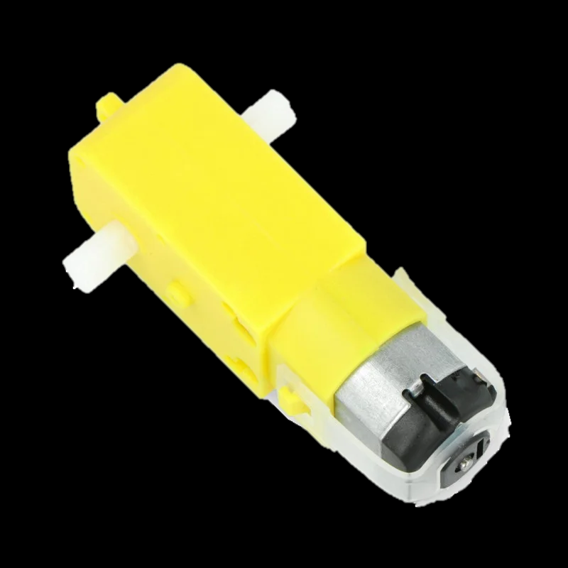
The Motor
In the prototype a yellow dc geared motor is used.
The motor has a gear box with ratio 48:1 which is increase the torque of the motor to 0.8 kg*cm (0.078 Nm) and the motor can rotate at 90 ± 10 rpm.
The motor is operated at 5 volts and draws an average current of 250mA maximum.

Slide 3
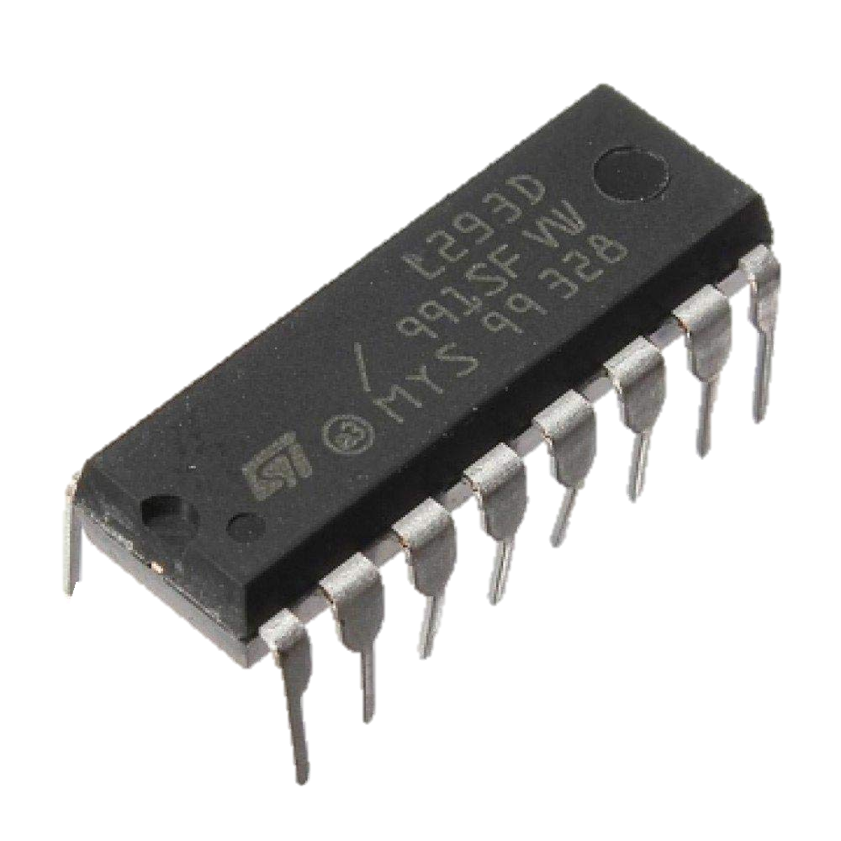
The Motor driver
In the prototype l293D motor driver IC is used which is capable of controlling motors with operating voltages up to 36 volts and maximum output current up to 1.2 ampere.
This motor driver will be very good in our application because it can control the used geared dc motor and its size is small.

